Slide 1

User Manual
Payroll Management

Slide 2
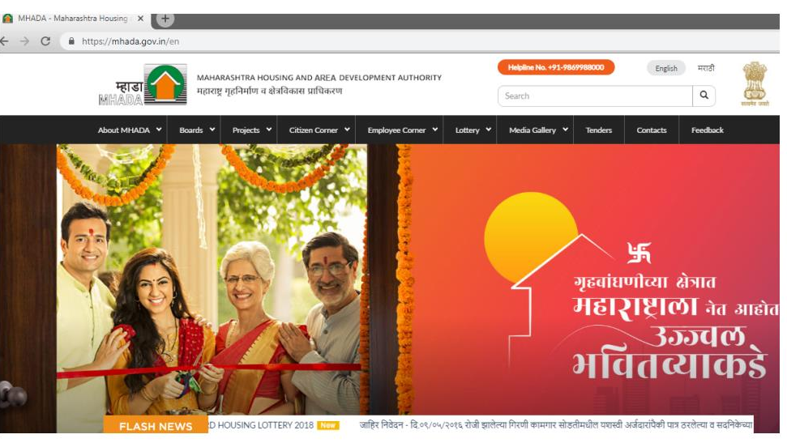
Enter URL in the Address bar : https://mhada.gov.in/en then Click on English Version

Slide 3
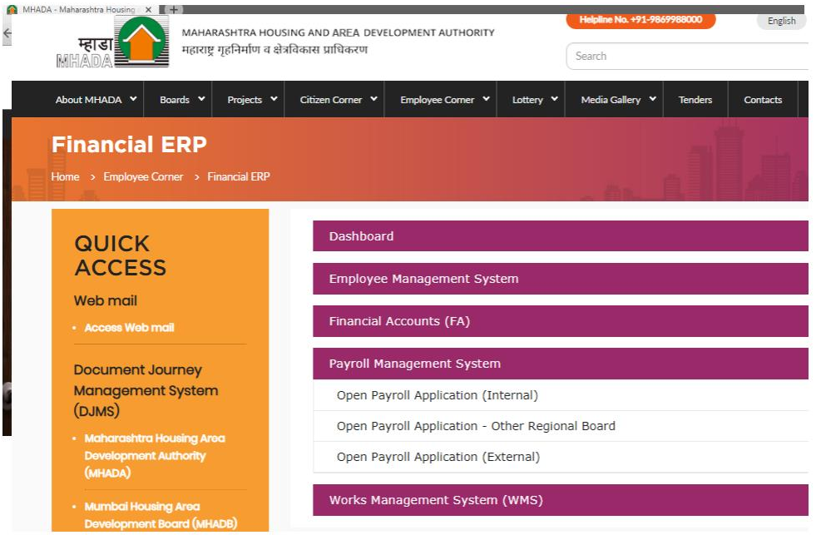

Then Click on Employee Corner - Financial ERP System.
Then Click on Open Payroll Application

Slide 4
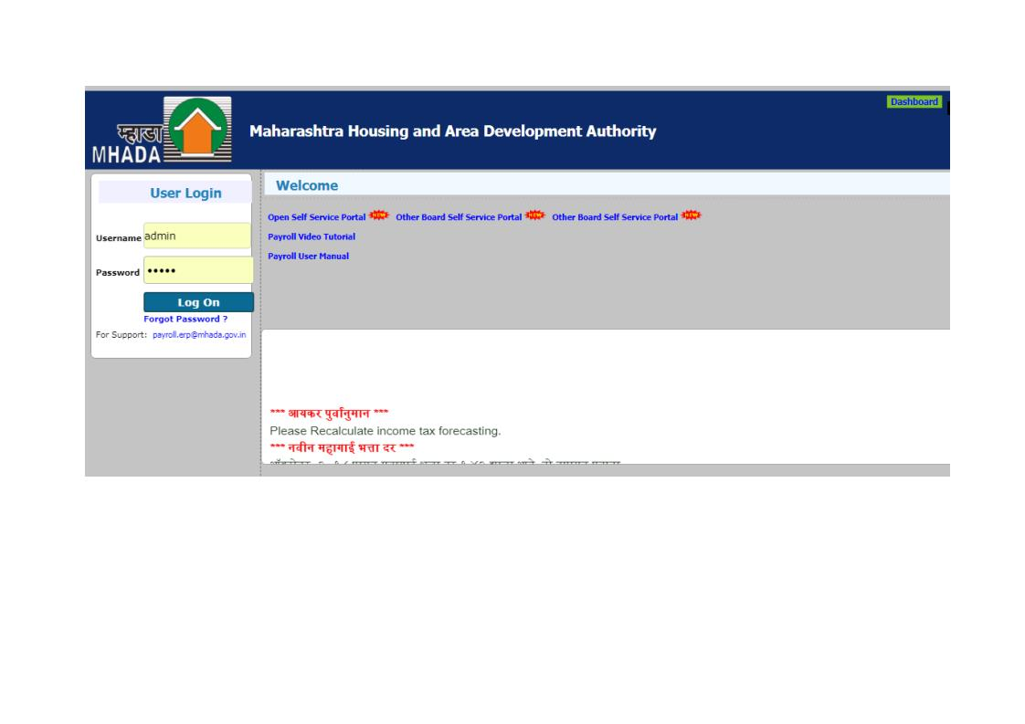
The Login Page(Home page) will appear.

Slide 5
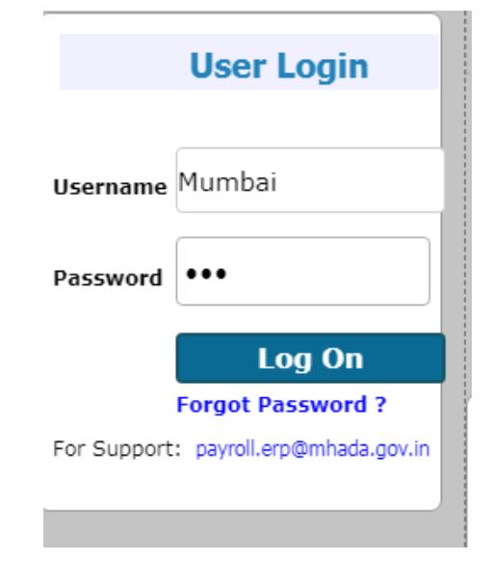
For MHADA User Login :
Enter your User Name and Password and click on Login Button.
Enter User Name Here
Enter Password Here
Click here to Login

Slide 6
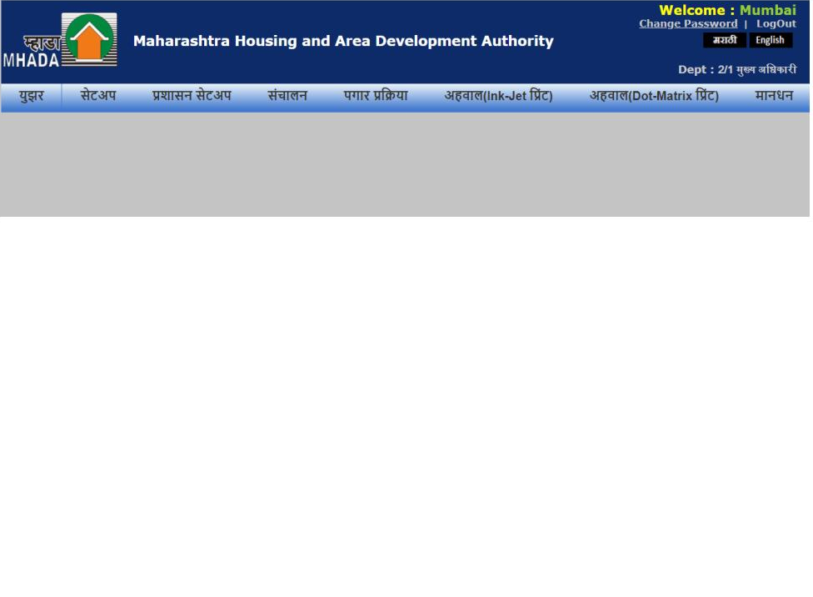
Home page will appear as :

Slide 7
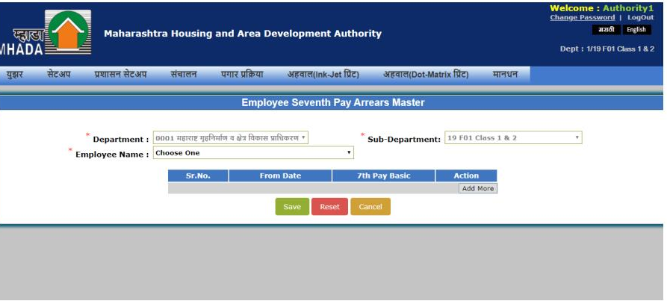
Process For Adding Employee Seventh Pay Arrears Master :
Take your Mouse pointer to the ‘ सेटअप ’ Menu as shown: Select ‘Employee Seventh Pay Arrears Master ’

Slide 8
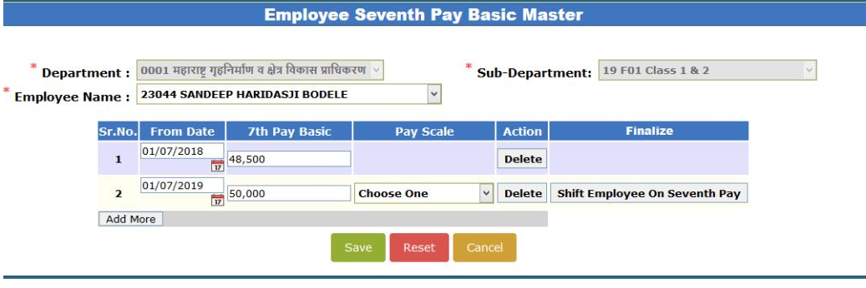
Select Employee Name:
Click on Form Date in Increment Date : For E.g 01-01-2016
Add – 7th Pay Basic Calculate for manually
Click Add More button
Click on Pay Scale
Click on shift to seventh pay employee
Save

Slide 9
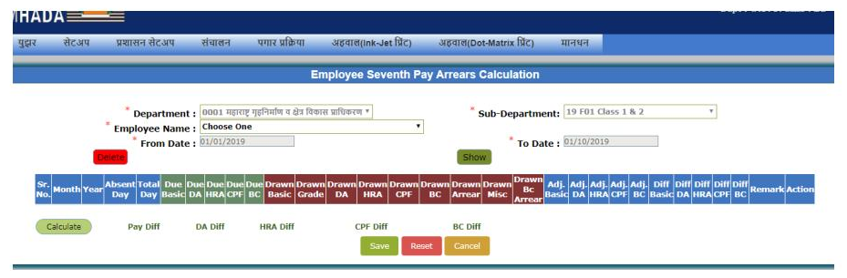
Process For Adding Employee Seventh Pay Arrears Calculation :
Take your Mouse pointer to the ‘संचालन ’ Menu as shown: Select ‘Employee Seventh Pay Arrears Master ’

Slide 10
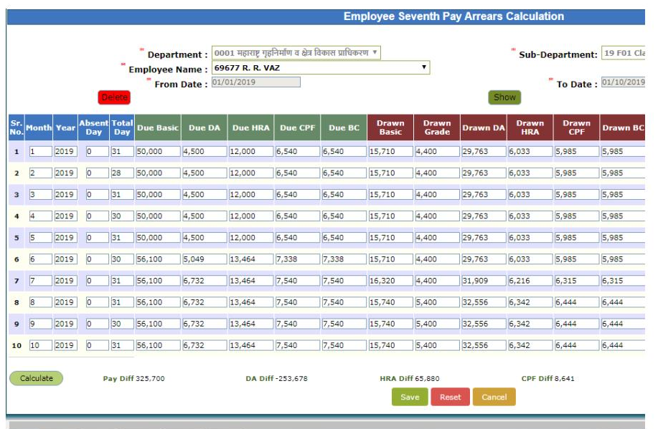
Select Employee Name click on Show Button

Slide 11
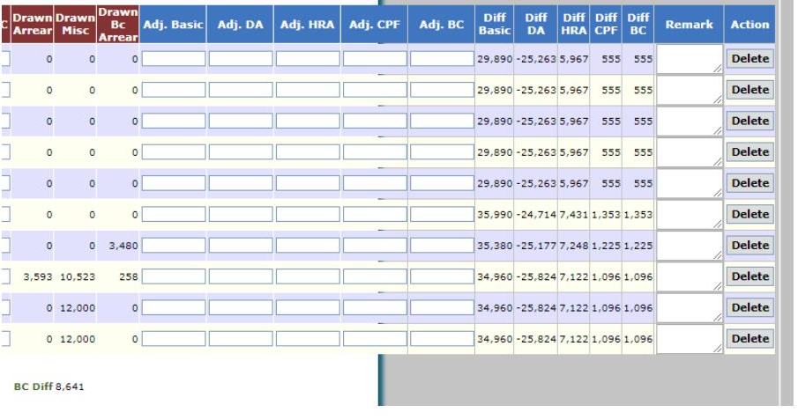
Select Employee Name click on Show Button

Slide 12
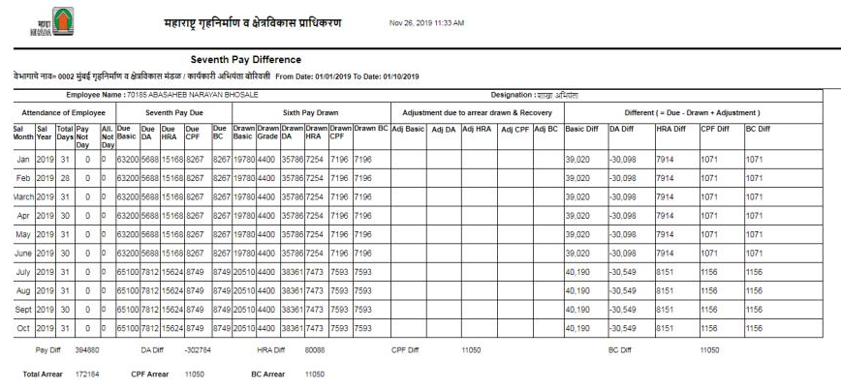
Process For Adding Employee Seventh Pay Report :
Take your Mouse pointer to the ‘अहवाल(Dot-Matrix प्रिंट)’
1. Menu as shown: Select ‘ Seventh Pay Arrears Report
2. Click on Show Button

Slide 13
Regular Salary Process
Attendance
Bill Create
Bill Process
Check All Report

Slide 14
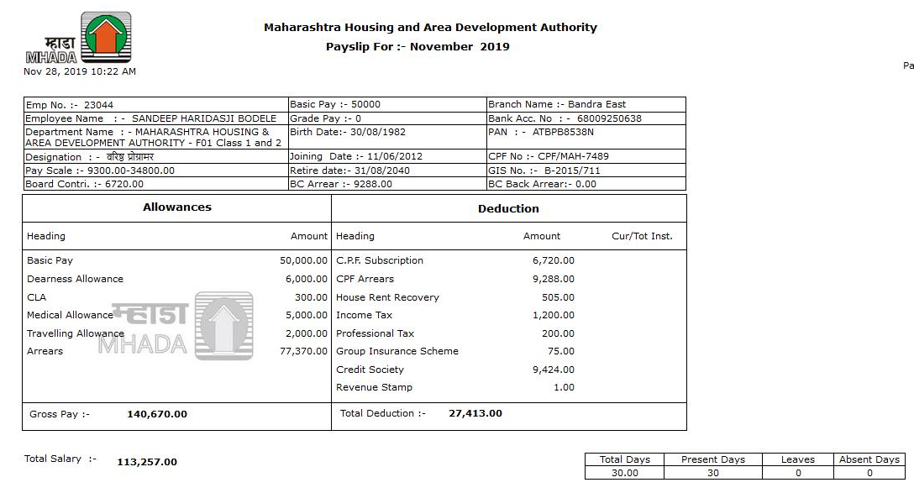
Payslip for November-2019

Slide 15


